Slide 1

Online News Popularity
Team Happy Hour
Aakanksha, Aditya, Angie, Anu, Maninee

Slide 2
Introduction
Set of features about online articles published by Mashable over a period of two years (c. 2015).
Goal is to predict whether an article is popular or not based on number of shares.
Number of attributes: 61 (58 predictive attributes, 2 non-predictive, 1 goal field)
Number of rows: 39797
Types of features:
Words: Words in title / content; Rate of unique / non-stop words
Digital Media: No. of links to other articles in Mashable; No. of images / videos
Keywords: No. of keywords; Article category
NLP: Closeness to 5 LDA topics; Title / content polarity
Target: Number of shares at Mashable
Notes:
Anu / Aditya
https://archive.ics.uci.edu/ml/datasets/Online+News+Popularity#
Median value
LDAs (statistical model) allows sets of observations to be explained by unobserved groups that explain why some parts of the data are similar. For example, if observations are words collected into documents, it posits that each document is a mixture of a small number of topics and that each word's presence is attributable to one of the document's topics.

Slide 3
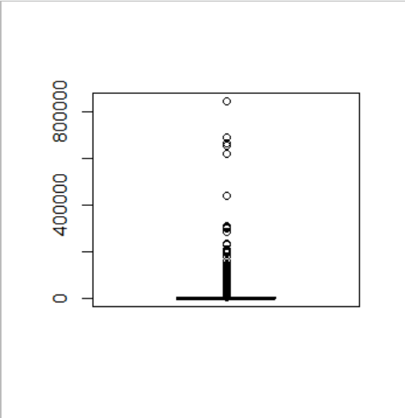
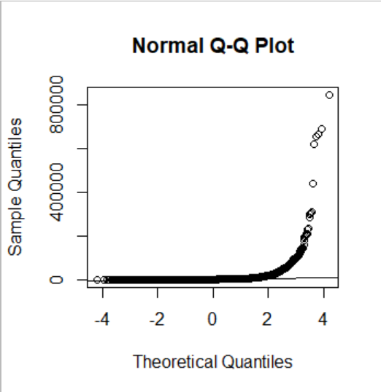
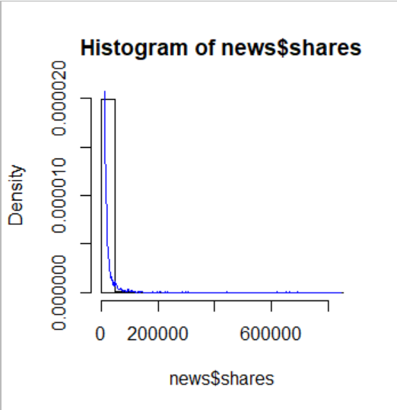
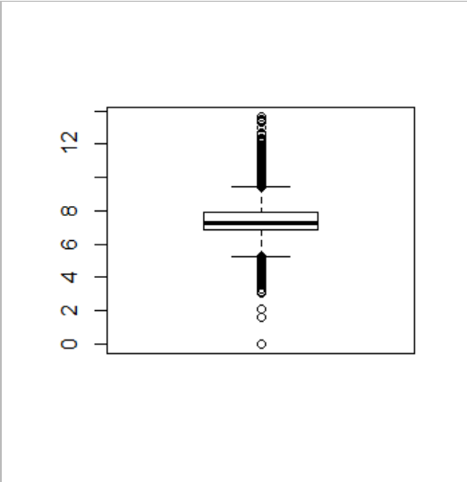
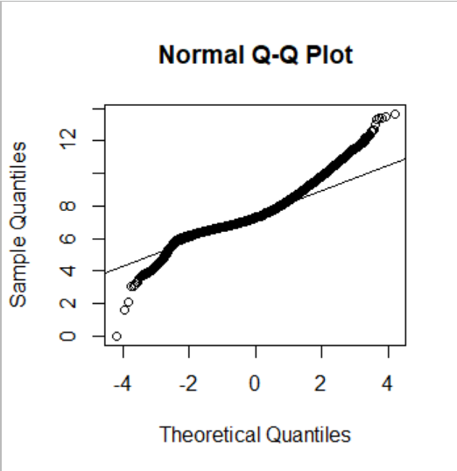
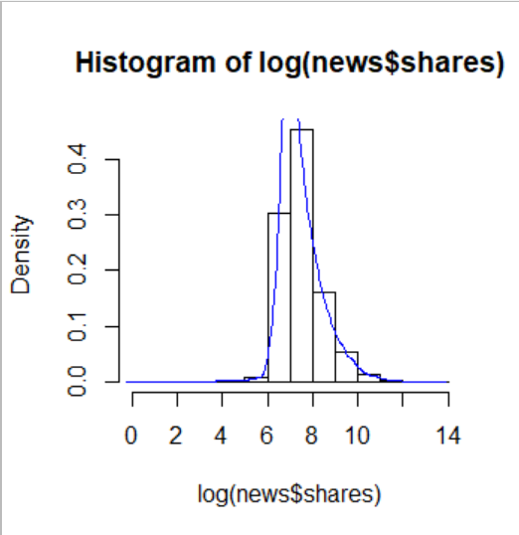
Dependent variable - Number of shares
Without transformation (non centered, non linear and right skewed)
With log transformation (more centered, linear and normally distributed)
Notes:
Anu

Slide 4
Feature selection
First, performed logistic regression on all variables (58)
Using above fit, performed stepwise logistic regression to select best subset of variables (36)
Applied Boruta algorithm on the best subset of variables to obtain our final subset of variables (32)
Boruta is a feature selection algorithm based on Random Forest which creates shadow features
It then randomly shuffles values for each feature to remove correlation and compares them to original features for importance
PCA was not used since that results in degrading the model results
Notes:
Aditya
Iterative approach
Random Forest but importance Z scores classifies as confirmed, tentative, rejected

Slide 5
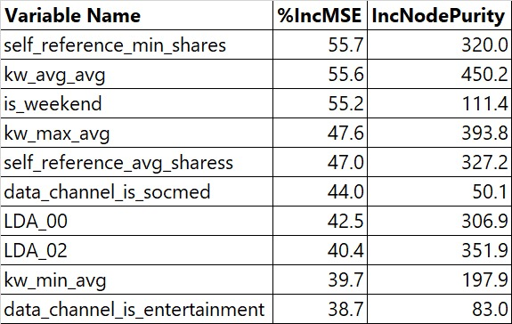
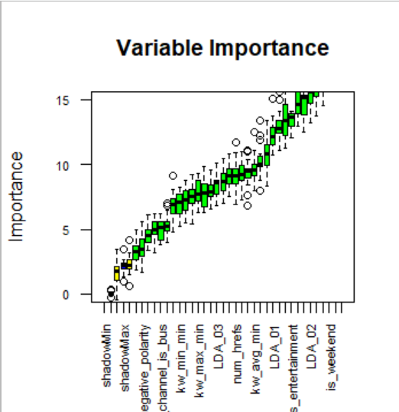
Important predictors
Notes:
Aditya
MSE is more robust measure due to OOB testing rather than Inc In Node Purity
28. self_reference_min_shares: Min. shares of referenced articles in Mashable
27. kw_avg_avg: Avg. keyword (avg. shares)
38. is_weekend: Was the article published on the weekend?
26. kw_max_avg: Avg. keyword (max. shares)
30. self_reference_avg_sharess: Avg. shares of referenced articles in Mashable
25. kw_min_avg: Avg. keyword (min. shares)

Slide 6
Independent variables (Predictors)
Weak Predictors (Categorized as tentative by Boruta and low importance in RF)
Title subjectivity and absolute title subjectivity
Number of words in the title
Article type is lifestyle or business
Polarity of article
Little or no relationship (Very high p-value > 0.5)
Weekday is Monday, Tuesday etc
LDA_04 has perfect collinearity with other variables (singularity)
Number of images or videos
Article type is world
Lastly, when we run lasso regression we can observe that features like article type is world, no. of videos, article polarity etc have been regularized by shrinking their coefficients to 0.
Notes:
Aditya
56. title_subjectivity: Title subjectivity (sentence expresses an opinion or not)
57. title_sentiment_polarity: Title polarity
58. abs_title_subjectivity: Absolute subjectivity level
2. n_tokens_title: Number of words in the title

Slide 7
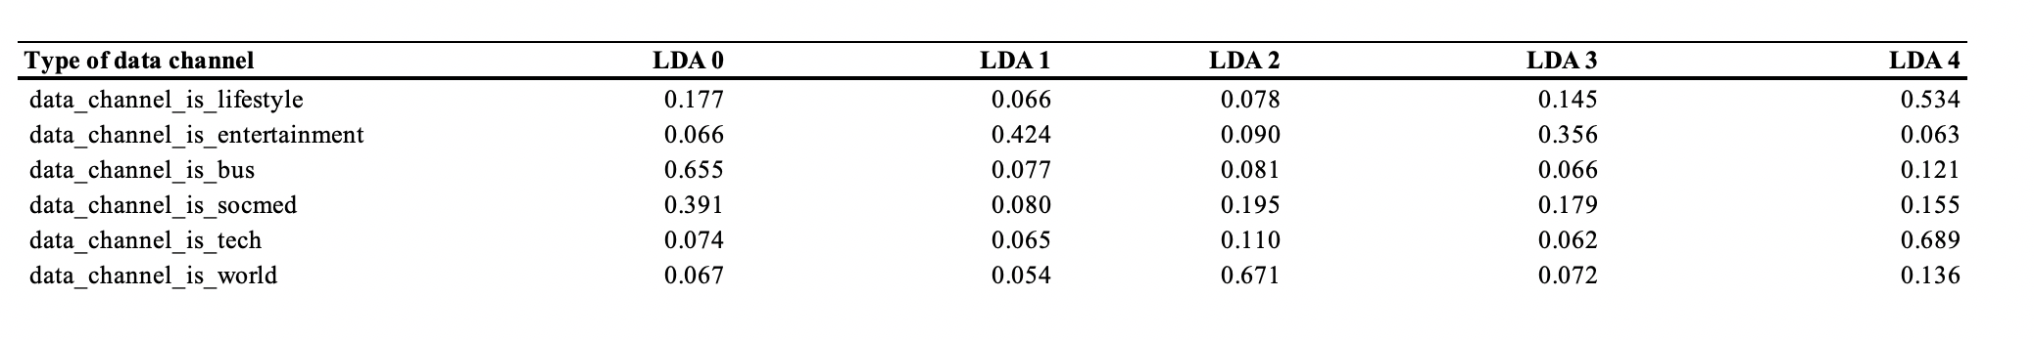
Relationship b/w predictors
Data channel vs LDA topics
The dataset does not provide any LDA topic information
Looking at the average value of LDA (lower is closer) we can see for example lifestyle articles are similar to LDA1, entertainment articles to LDA4, technology articles to LDA3 etc.
Notes:
Anu
56. title_subjectivity: Title subjectivity
57. title_sentiment_polarity: Title polarity
58. abs_title_subjectivity: Absolute subjectivity level
2. n_tokens_title: Number of words in the title

Slide 8
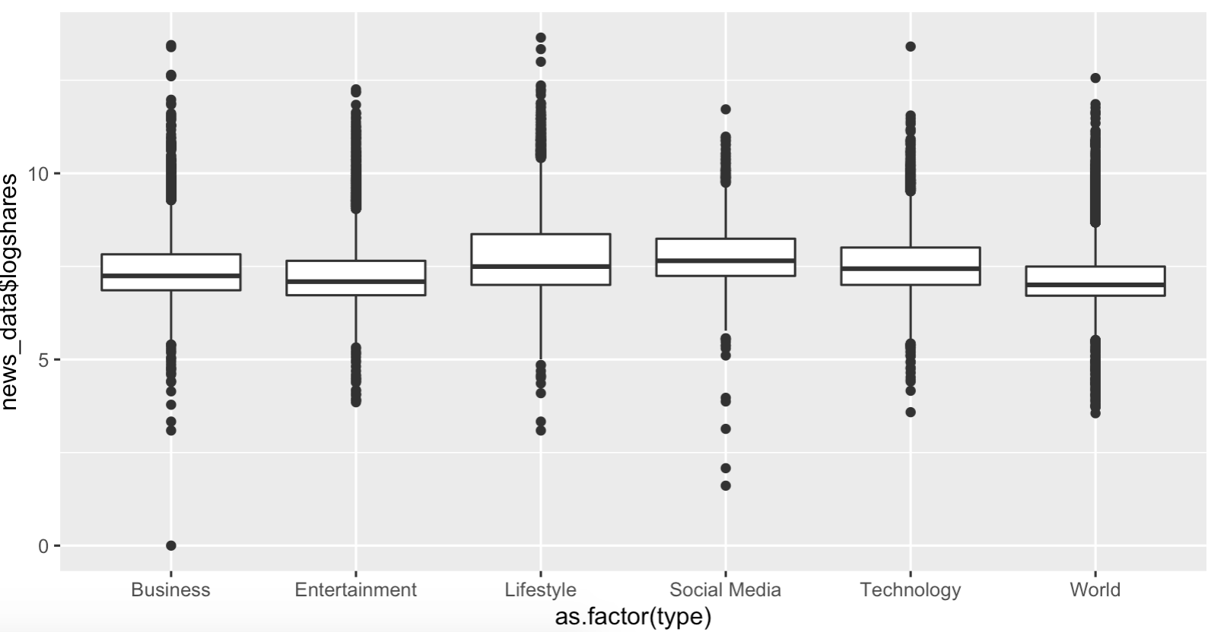
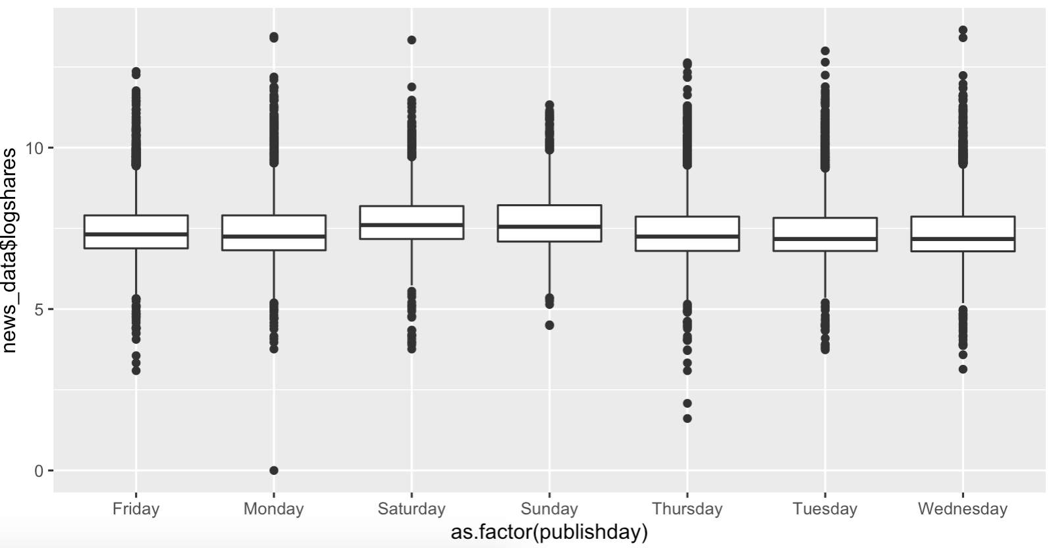
Categorical predictors
Type of article vs Popularity
Publishing day vs Popularity
Notes:
Anu
Don’t really have that much of a difference on the dependent variable

Slide 9
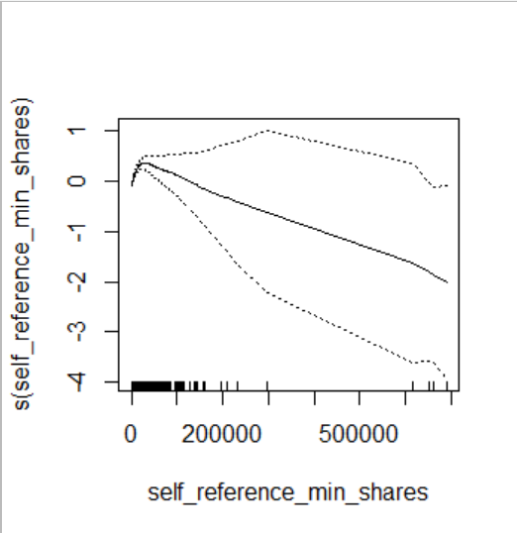
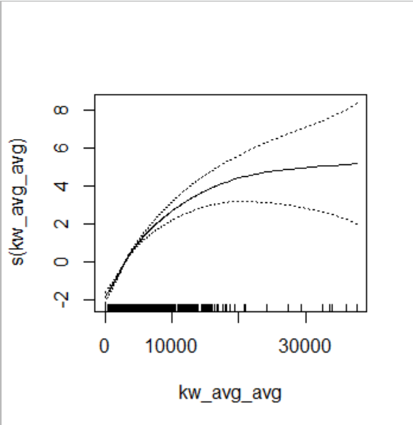
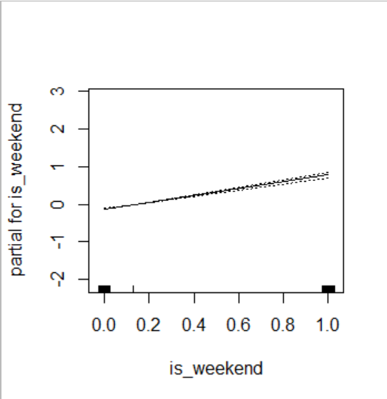
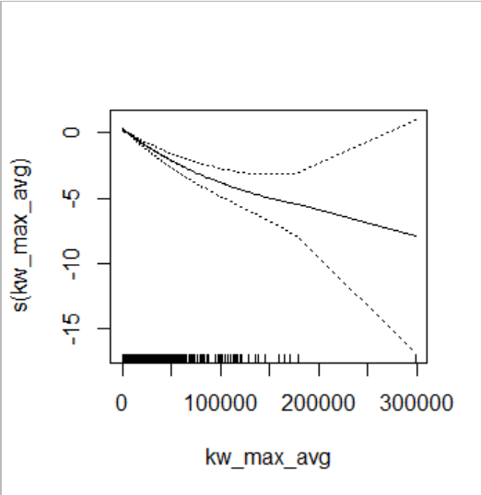
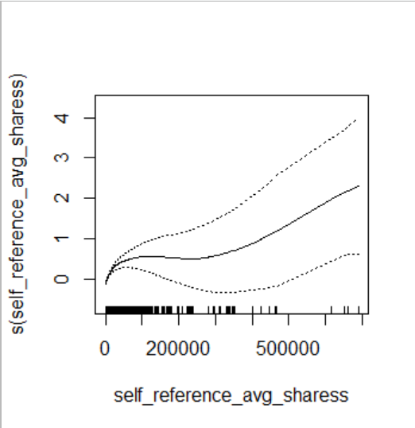
Relationship with important predictors
Notes:
Aditya
Scaling or no scaling doesn’t matter
28. self_reference_min_shares: Min. shares of referenced articles in Mashable
27. kw_avg_avg: Avg. keyword (avg. shares)
38. is_weekend: Was the article published on the weekend?
26. kw_max_avg: Avg. keyword (max. shares)
30. self_reference_avg_sharess: Avg. shares of referenced articles in Mashable
25. kw_min_avg: Avg. keyword (min. shares)

Slide 10
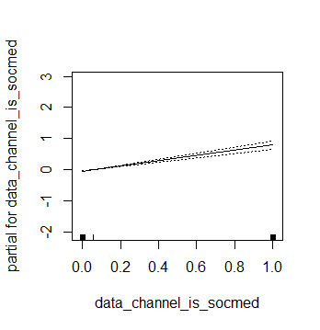
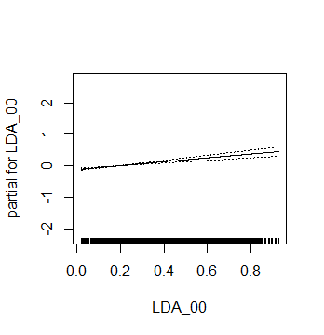
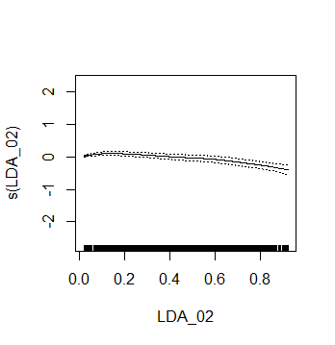
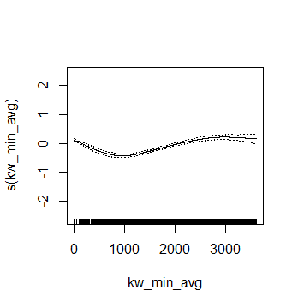
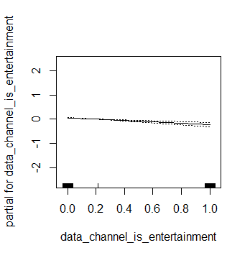
Relationship with important predictors
Notes:
Aditya

Slide 11
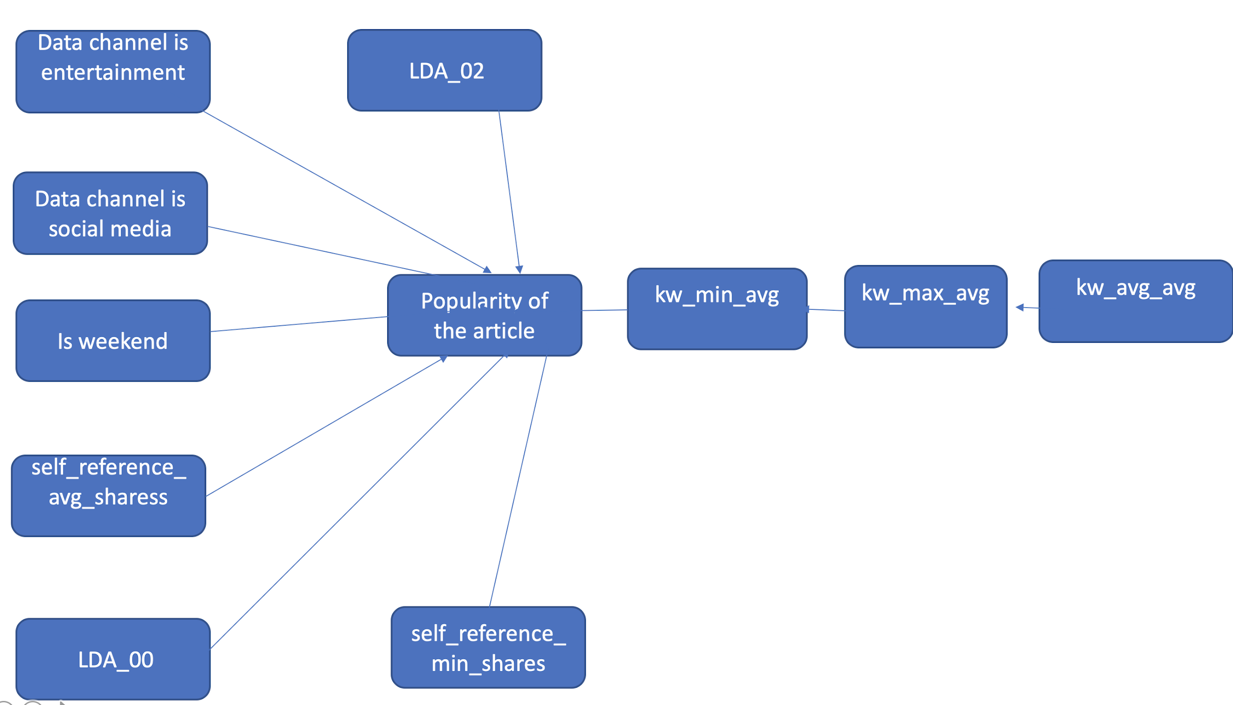
Relationship b/w important predictors
Notes:
Anu

Slide 12
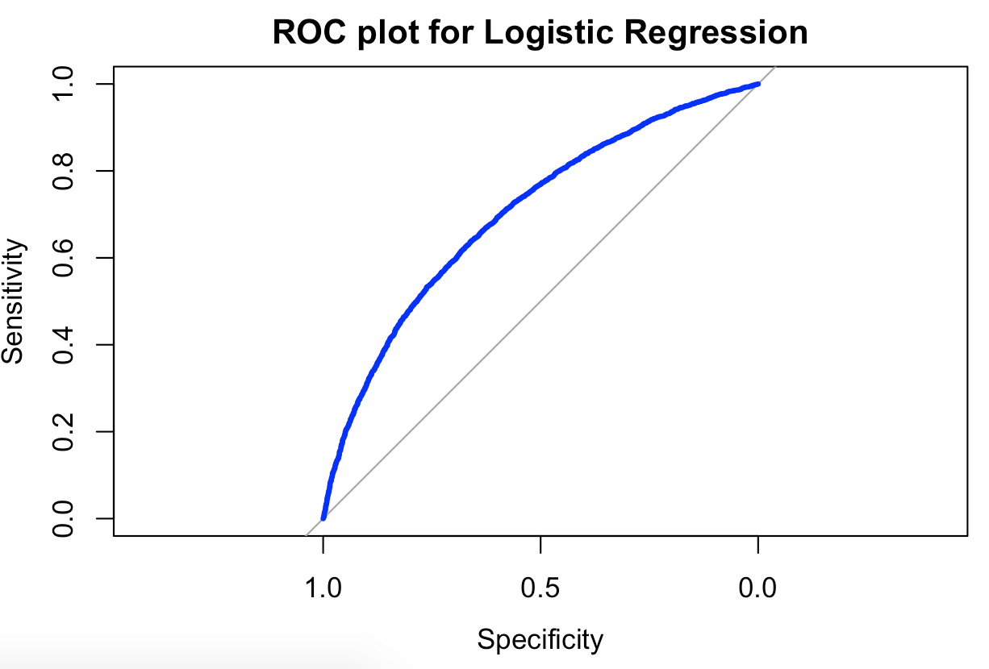
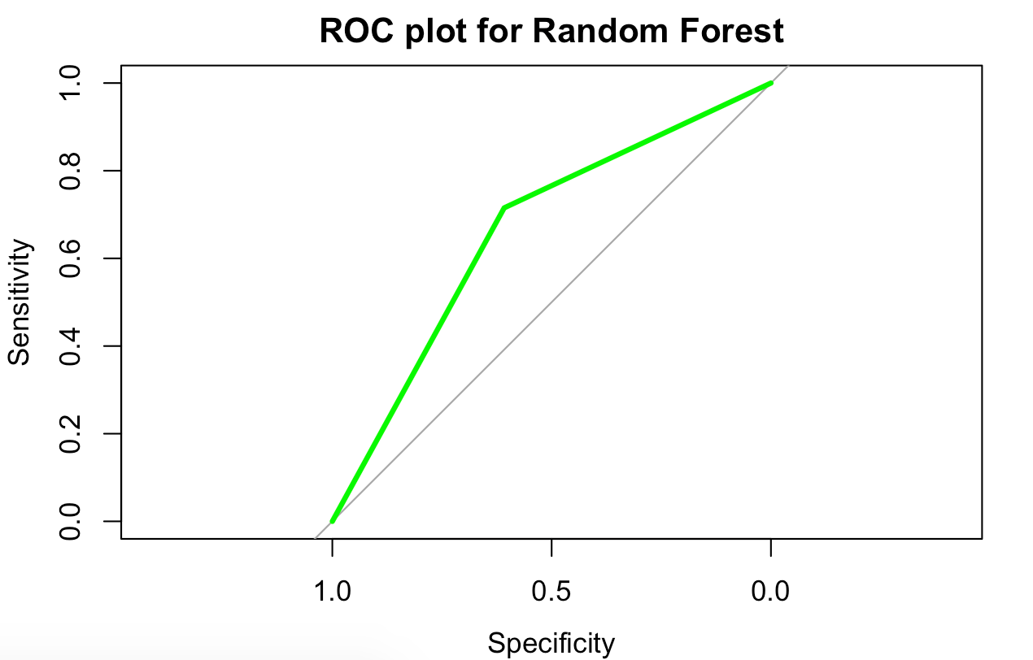
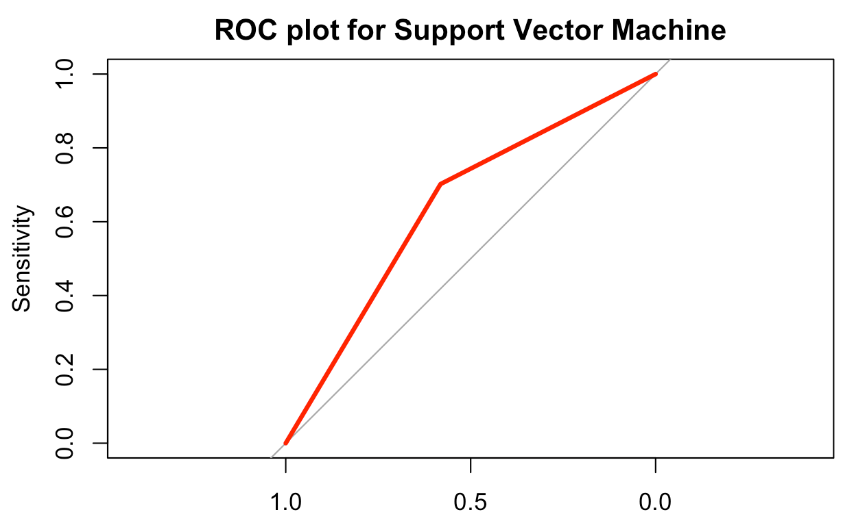
Model ROCs
Area under the curve: 70.19%
Area under the curve: 66.17%
Area under the curve: 64.17%
Notes:
Anu

Slide 13
Model scorecard
Model | Accuracy (%)
Logistic Regression | 65.89
Stepwise Regression | 63.01
Random Forest | 67.65
SVM (kernel - polynomial) | 65.26
Ridge Regression | 62.71
Lasso Regression | 63.08
GAM (with splines) | 64.29
Notes:
Aditya
Polynomial - works with interaction, non linear models

Slide 14
Recommendation
Traits for popular articles:
Articles posted on the weekend are more popular
Articles based on social media get more shares while articles based on entertainment get fewer shares
Similarly, articles close to LDA02 get more shares while articles based on LDA00 get fewer shares
Future work:
Work on creating NLP features ourselves to better understand what each topic means, essentially working with all words in the articles
Work on data cleaning for the features in depth to create a better explained model
Notes:
Aditya
Tried scaling, but maybe more transformation

Slide 15
Thank You! Questions?

Slide 16
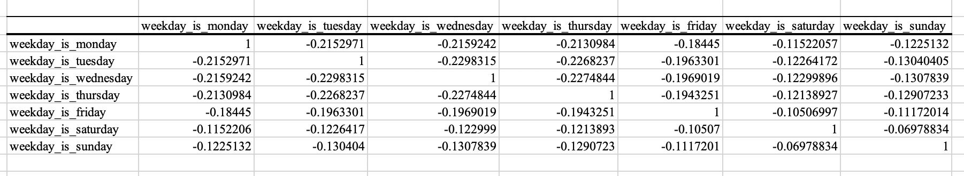
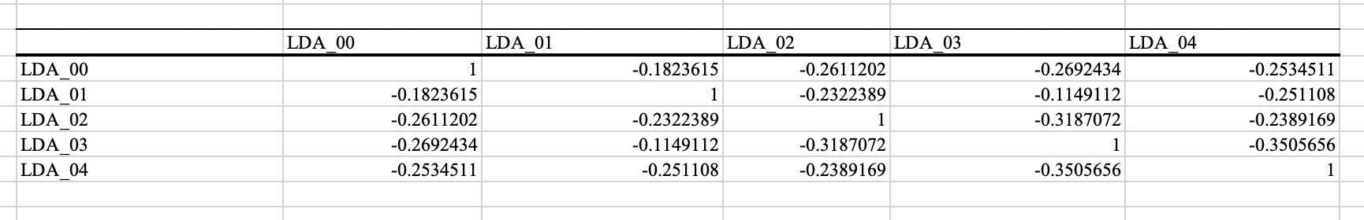
Appendix

Slide 17
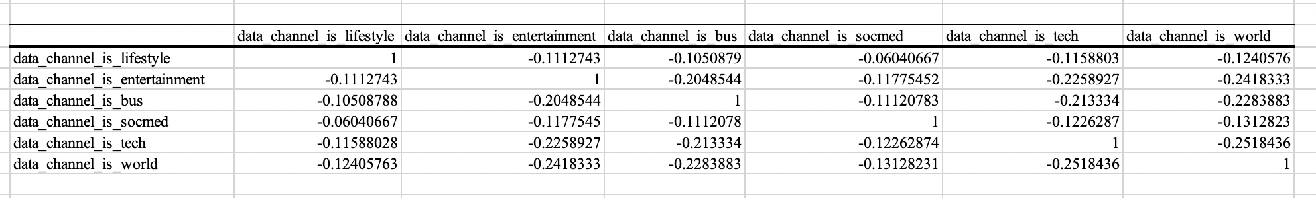
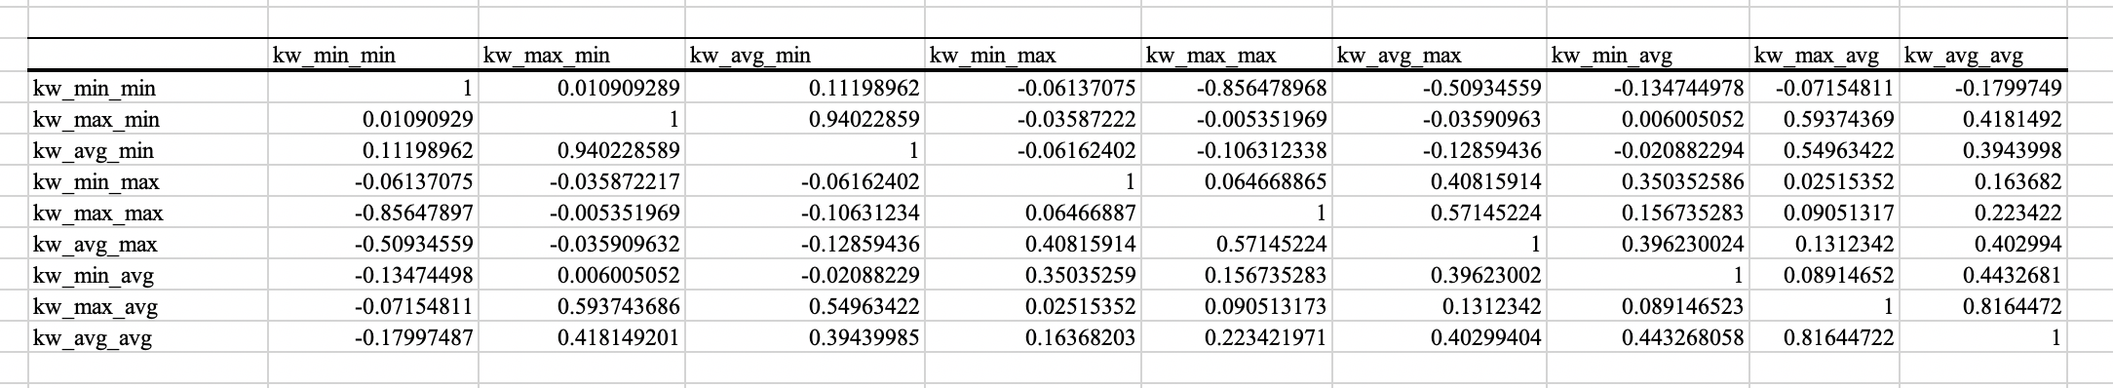
Appendix

